Slide 1

Puducherry Technological University Department of Computer Science and Engineering
An Integrated Platform for Handwritten Mathematical Expression Recognition and Adaptive Problem Solving
Presented By, Under the Guidance of,
Kondi Nanda Gopal Umesh Raju 21CS1017 Dr. Sagayaraj Francis,
Vengadesa Boopathi P 21CS1058 Professor
Gopesh A 21CS2003

Slide 2
1. Introduction
Mathematical problem-solving involves two critical challenges: digitizing handwritten equations and computing accurate solutions. Traditional tools address these tasks in isolation, requiring manual transcription or limiting users to pre-typed equations our project integrates:
AI-Powered OCR: Converts handwritten equations to LaTeX with 59.57%, The target Expression Recognition Rate (ExpRate) .
Adaptive Solver Engine: Combines symbolic (SymPy) and numeric (SciPy) methods, dynamically selected via ML for algebra.
Specialized Solvers: Trigonometry, matrices, and calculus.
Web Interface: React frontend for input and Flask backend for scalable processing.
This unified platform serves students, educators, and researchers, automating the entire workflow from handwritten input to verified solutions.

Slide 3
2. Project Overview
HMER Extraction:
Input: Handwritten mathematical expression image. Processing: Preprocessing (e.g., resizing, normalization) → Feature extraction. Model: CNN-based visual feature extractor (e.g., ResNet or CNN layers) + Graph Encoder + Transformer Decoder Output: LaTeX representation of the handwritten expression.
Solver System:
Algebra: ML-based method selection (symbolic/numeric) using features like equation degree and term count.
Trigonometry: Symbolic solutions with periodic term detection.
Matrices: Operations (inverse, multiplication) via NumPy.
Calculus: ODE/PDE solving with SymPy and numerical fallbacks.
Web Application:
Frontend (React): Image upload, LaTeX preview, solution display.
Backend (Flask): REST APIs for OCR

Slide 4
3. LITERATURE REVIEW BASED ON VARIOUS RESEARCH PAPERS
Offline Handwritten Mathematical Expression Recognition with Graph Encoder and Transformer Decoder
This paper proposes an end-to-end architecture for recognizing handwritten mathematical expressions using a graph encoder and Transformer decoder. The method captures the spatial relationships between symbols through a Graph Attention Network (GAT), which significantly improves layout interpretation. The Transformer decoder then generates LaTeX sequences that reflect the original handwritten input with high accuracy.
Stroke Extraction for Offline Handwritten Mathematical Expression Recognition
The authors introduce a method to extract pen-stroke order from offline handwritten expressions by applying skeletonization and morphological tracing techniques. Recovering the stroke sequence helps in understanding symbol layout and improves the structure recognition stage. This is especially useful when segmenting closely spaced or overlapping mathematical symbols.

Slide 5
Comparison Study on Optical Character Recognition Models in Mathematical Equations and in Any Language
This study evaluates the performance of various OCR models on mathematical and multilingual text recognition tasks. It highlights the limitations of standard OCR tools when applied to mathematical expressions and recommends deep learning-based solutions. The paper serves as a benchmark for selecting suitable OCR approaches in math-intensive applications.
Watch, Attend and Parse: An End-to-End Neural Network Based Approach to Handwritten Mathematical Expression Recognition
This early neural approach treats HMER as a sequence generation task, using an attention-based encoder-decoder framework. The model applies attention to visual features to identify symbol regions, bypassing the need for explicit segmentation. It marked a significant shift towards end-to-end deep learning in mathematical expression recognition.
Image-to-Markup Generation with Coarse-to-Fine Attention
The authors propose a hierarchical attention mechanism that first focuses on broader regions and then zooms in on detailed parts of the expression. This improves recognition accuracy, especially in dense or structurally complex areas. The approach effectively bridges visual input and structured LaTeX output.

Slide 6
SymPy: Symbolic Computing in Python
SymPy is an open-source Python library used for symbolic mathematics, supporting algebra, calculus, and matrix computations. It plays a key role in this project as the backend solver for recognized LaTeX expressions. The library’s flexibility and symbolic engine make it ideal for automated math solving systems.
Symbolic Integration with SymPy: Algorithms and Applications
This work explains the symbolic integration techniques used in SymPy and demonstrates their effectiveness in solving complex integrals. It describes algorithmic strategies such as rule-based rewriting and recursive solving. These capabilities are crucial for automating mathematical solution generation in symbolic systems.
Hybrid Symbolic-Numeric Methods for Solving Algebraic Equations
This paper presents a combined approach where simpler parts of equations are solved symbolically, and complex or non-linear parts are handled numerically. It ensures both computational efficiency and solution accuracy. The hybrid model is suitable for large-scale algebraic systems often encountered in engineering.
Dynamic Approach Selection for Solving Mathematical Problems: Symbolic or Numeric
The authors propose a machine learning-driven system that classifies math problems to choose between symbolic and numeric solving paths. By analyzing expression features, the system dynamically selects the most efficient method. This adaptive approach improves the performance of math-solving software under diverse inputs.

Slide 7
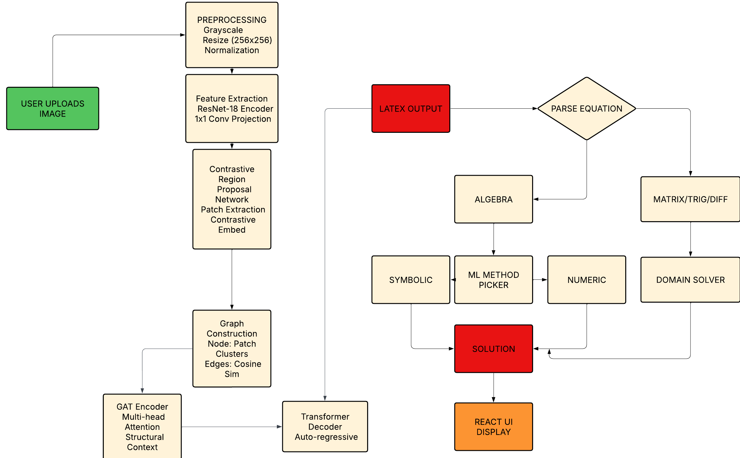
4. END TO END PIPELINE OF PROPOSED WORK

Slide 8
5. OFFLINE HANDWRITTEN/ PRINT MATH EXPRESSION RECOGNITION

Slide 9
5.1 EXISTING APPROACH OF OFFLINE HMER
Topic : Offline handwritten mathematical expression recognition with graph encoder and transformer decoder
The paper addresses the challenge of Offline Handwritten Mathematical Expression Recognition (HMER), which involves converting images of handwritten equations into structured markup languages like LaTeX by proposing a Graph-Encoder-Transformer-Decoder (GETD) framework that explicitly detects symbols, models their spatial relationships, and generates LaTeX sequences while maintaining interpretability.

Slide 10
Existing Architecture
The GETD framework consists of four key stages:
Symbol Detection:
Uses YOLOv5 to localize candidate symbols in the input image.
Detected symbols are treated as nodes in a graph, with bounding boxes but no initial class labels.
Graph Construction:
Nodes represent detected symbols.
Edges encode spatial relationships between symbols, determined by line-of-sight (LOS) neighborhood (symbols not occluded by others).
Node and edge features are extracted via CNN from the image’s visual feature map.

Slide 11
Graph Encoder (GNN):
A Graph Attention Network (GAT) aggregates spatial and structural information.
Node and edge features are updated iteratively through attention mechanisms, capturing contextual relationships.
Embedding guidance via auxiliary losses (node/edge classification) ensures meaningful feature learning.
Transformer Decoder:
Generates LaTeX tokens autoregressively using multi-head attention over the graph encoder’s output.
Employs bidirectional training (left-to-right and right-to-left decoding) to improve sequence modeling.

Slide 12
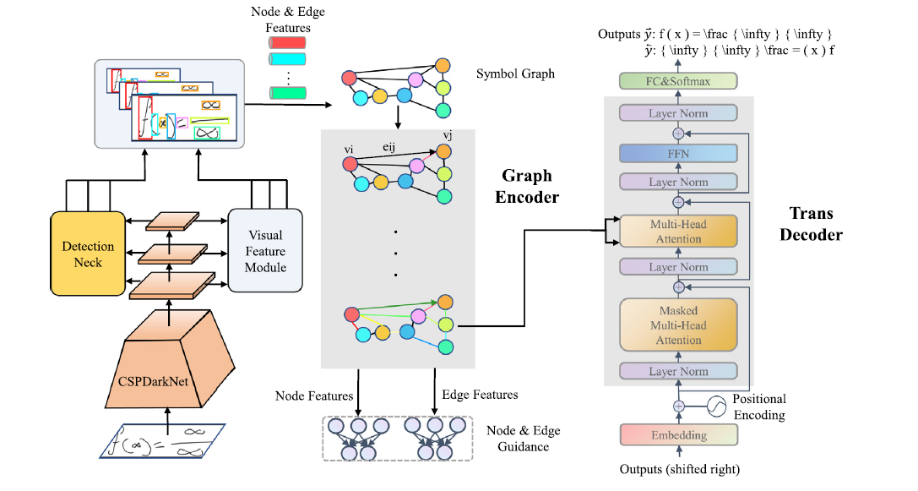
Existing System Architecture

Slide 13
Limitations of Existing Approach
1. Symbol Detection Dependency:
Errors in symbol localization (missed or false positives) propagate to graph construction and decoding.
2. Annotation Cost:
Requires some symbol-level annotated data for training the detector, though semi-supervised learning alleviates this.
3. Complex Structures:
Challenging spatial arrangements (e.g., nested fractions, overlapping symbols) may not be fully captured by LOS-based edges.
4. Performance Trade-off:
Achieves competitive but not state-of-the-art accuracy on datasets like HME100K, highlighting room for improvement.

Slide 14
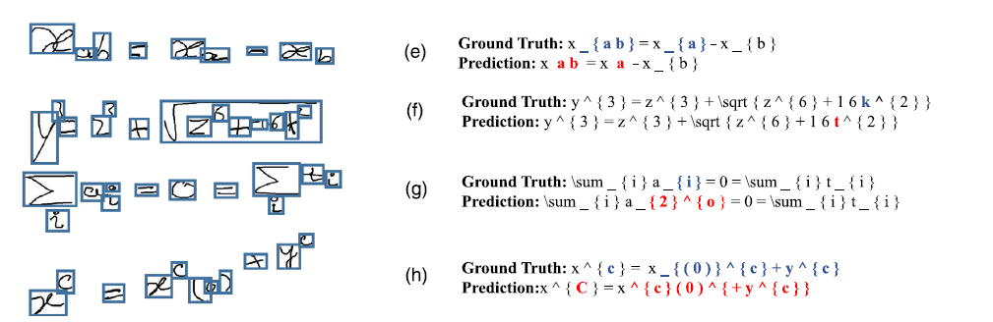
Sample Output Of Existing Approach

Slide 15
5.2 PROPOSED APPROACH OF OFFLINE HMER
Self-Supervised Patch-Based Region Proposal with Graph Neural Network Encoding for Handwritten Mathematical Expression Recognition
The system processes grayscale images via a ResNet-18 encoder followed by a 1×1 convolution to obtain compact features. These are divided into 16×16 overlapping patches and mapped into a 128D embedding space using a contrastive learning-based projection head, eliminating manual steps like binarization or skeletonization.
Patch embeddings are treated as nodes in a graph, with edges formed by connecting each node to its two most similar neighbors using cosine similarity. A multi-head Graph Attention Network (GAT) refines node features by modeling spatial and semantic relationships between symbol-like regions.
Refined graph features are passed as memory to a Transformer decoder that generates LaTeX sequences autoregressively using causal attention. The model is trained with a combined contrastive and cross-entropy loss, offering scalability, robustness to handwriting variation, and full end-to-end trainability without symbol-level annotations.

Slide 16
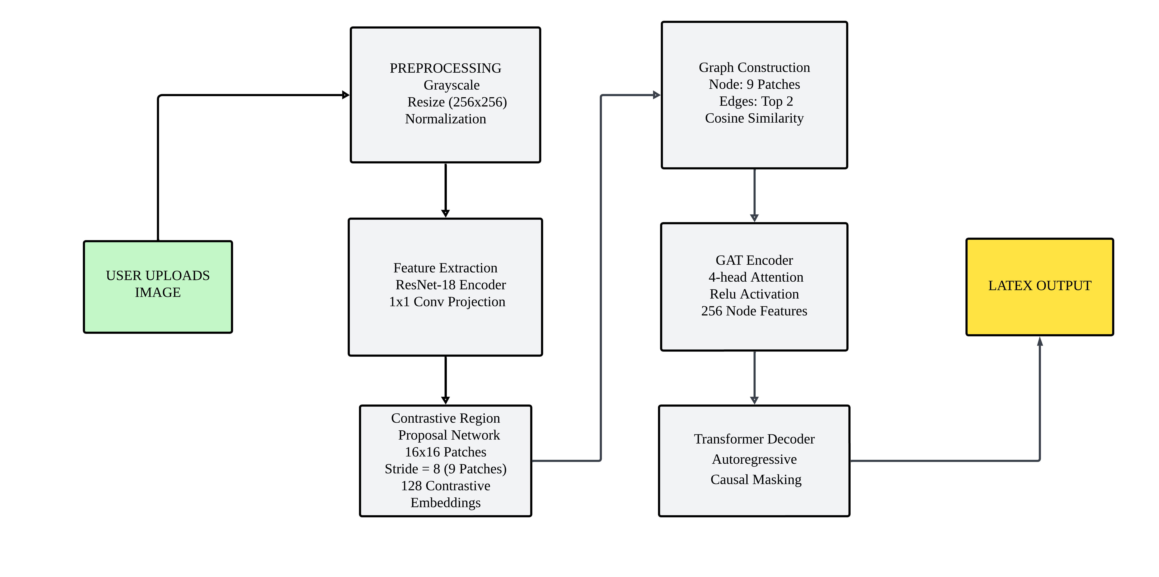
FLOWCHART OF OFFLINE HMER

Slide 17
5.2.1 ARCHITECTURE OF PROPOSED OFFLINE HMER
1. Dataset Collection and Preparation
Source: Offline Handwritten Images: Scanned or camera-captured images of mathematical expressions.
[ FROM CROHME2014, CROHME2016, CROHME2019 DATASET ]
Annotations: Each image is paired with a LaTeX sequence representing the equation.
Steps:
Image-Caption Pairing:
Stored images in a directory (e.g., /images).
Maintained a CSV file (annotations.csv) mapping image filenames to LaTeX captions.
Example CSV row: ["image_001.png", "\\sqrt{x + y}"].

Slide 18
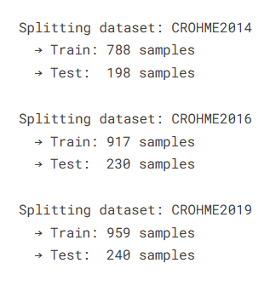
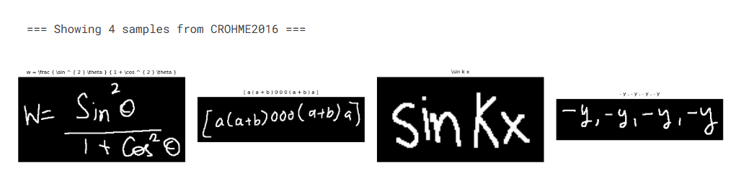
2. Train-Test Split:
Split the CSV into train.csv and test.csv (80-20 split)
3. Sample Images in Dataset

Slide 19
4. Preprocessing Pipeline
Grayscale Conversion (single‐channel normalization)
Resize: Uniform 256 × 256 image resolution
ToTensor: Scale pixels to [0, 1] float range
Augmentations: Random rotations, elastic distortions, stroke‐preserving noise
Normalization: Scale features to [0, 1] per channel.
5. Modified CNN Encoder Adapts a ResNet‐style backbone for single‐channel inputs and removes the initial max‐pooling to retain every pixel’s stroke information.
Early Layers: 3×3 convolution preserves fine gradient changes, ensuring that hair‐thin fraction bars and accent marks remain intact.
Deep Layers: Subsequent blocks capture complex junctions and loops, converting low‐level edges into coherent symbol shapes without resolution loss.

Slide 20
6. 1×1 Convolution Projection Introduces a pointwise convolution to shrink feature depth from 512 to 256 channels, keeping the 32×32 spatial grid unaltered.
7. Contrastive Region Proposal Network (CRPN) Extracts overlapping 16×16 patches (stride 8) from the projected feature maps
Patch Extraction:
Sliding Window: 16×16 patches with stride 8 (overlap = 75%).
Flattening: Each patch → 16×16×256 = 65,536D vector.
Self-Supervised Embedding:
Projection Head: MLP (65k → 256 → 128D).
Contrastive Loss (NT-Xent):
Maximizes similarity between augmented views of same patch.
Minimizes similarity between different patches.

Slide 21
8. Graph Construction Engine Constructs a dynamic, sample‐specific graph by connecting each region node to its two most similar peers based on cosine similarity.
Self‐Loops: Retains original node features to anchor each patch’s identity during GAT aggregation.
Bidirectional Edges: Ensures undirected information flow, linking numerators, operators, and denominators in expressions like fractions.
Nodes: All 9 patches per image
Edges:
Top-2 Cosine Similarity: Connect each node to its 2 most similar patches.
Bidirectional: Symmetric relationships (𝑖 ↔ 𝑗).

Slide 22
9. Graph Attention Network (GAT) Encoder
Multi‐Head Focus: Separate heads learn to emphasize spatial alignment, operator styles, or group affinities (e.g., matrix entries).
Nonlinear Fusion: Applies ReLU after concatenation to model complex symbol interactions and suppress irrelevant neighbor noise.
GAT Encoder:
Layer 1: 4-head attention → 512D concatenated features.
Layer 2: 1-head attention → 256D unified features.
ReLU Activation: Non-linear aggregation.
10. Encoder Output:
Final Node Embeddings: Each node now contains information aggregated from its local region and its spatially connected neighbors-encoding both patch-level and relational context.
Shape: [B, num_nodes, hidden_dim] (e.g., [B, 20, 128]).

Slide 23
11. Transformer Decoder
Inputs to the Decoder
Memory:
Source: Output from the GAT encoder.
Shape: [num_nodes=9, batch_size=1, emb_dim=256].
Role: Provides structural context (e.g., symbol relationships like superscripts, fractions).
Target Sequence:
Training: Ground-truth LaTeX tokens (shifted right).
Inference: Autoregressively generated tokens.
Embeddings: Learnable token vectors (vocab_size → 256D).

Slide 24
12. Positional Encoding
Purpose: Injects order information into token embeddings.
Method:
Sinusoidal Encoding: Fixed wavelengths for each dimension.
Formula:
Output: [seq_len, batch_size, emb_dim].
13. Transformer Decoder Layers
Each layer processes data through:
Masked Self-Attention:
Focus: Relationships between LaTeX tokens (e.g., x ↔ ^ in x^2).
Masking: Upper-triangular matrix prevents attending to future tokens.

Slide 25

14. Cross-Attention:
Query: Current decoder state.
Key/Value: Encoder memory (GAT’s graph nodes).
Mechanism:
Role: Aligns LaTeX generation with relevant symbol regions (e.g., focuses on "√" when generating \sqrt).
15. Feed-Forward Network:
Structure: Two linear layers with ReLU activation.
Dimension: 256 → 1024 → 256
16. Autoregressive Generation
Training (Teacher Forcing):
Input: [<SOS>, token_1, ..., token_{n-1}].
Target: [token_1, ..., token_n, <EOS>].
Loss: Cross-entropy between predictions and ground truth.

Slide 26
17. Inference (Greedy Decoding):
Start with <SOS>.
At step t:
Generate logits for next token: output = decoder(memory, input_sequence).
Select token with max probability: token_t = argmax(output[:, -1]).
Append to input: input_sequence = concat(input_sequence, token_t).
Stop at <EOS> or max length (100).
18. Output & Loss
Output: The decoder produces a sequence of logits over the vocabulary for each time step (except the last, since we predict the next token).
Loss: Standard cross-entropy loss is computed between the predicted logits and the ground-truth LaTeX sequence (shifted by one token).

Slide 27
19. Training Loop
Setup & Hyperparameters
Epochs: 20 , Batch Size: 8
Optimizer: Adam (lr = 1e-4)
Loss: CrossEntropy (ignoring <PAD>)
Data Loading
Train Loader: shuffle, batch=8, 2 workers.
Test Loader: batch=1, sequential, 1 worker
Per-Epoch Process
Train Mode: enable dropout & batch-norm updates
Forward Pass: compute logits for all time-steps
Loss Computation: compare logits vs. ground-truth tokens
Metrics Update: accumulate epoch loss & accuracy

Slide 28

7. EVALUATION METRICS
Evaluating the effectiveness of a Handwritten Mathematical Expression Recognition (HMER) system involves several performance metrics that reflect different aspects of the model's recognition capability. These metrics help in analyzing not just the overall accuracy but also the structural and token-level correctness of predicted expressions.
1. Expression Recognition Rate (ExpRate)
The percentage of correctly predicted entire expressions, where the predicted LaTeX matches the ground truth exactly.
This is the most direct measure of model effectiveness. A high ExpRate means the model is accurately interpreting whole mathematical expressions, which is critical in practical applications.

Slide 29

2. Top-k Accuracy (≤1, ≤2)
Definition: These metrics evaluate whether the ground truth expression appears within the top k model predictions .
≤1 Accuracy: Equivalent to top-1 accuracy (same as ExpRate).
≤2 Accuracy: Checks if the correct prediction is within the top 2 outputs from the model.
3. Loss
The average value of the loss function ( Cross-Entropy ) over training data.
A decreasing loss indicates that the model is learning and improving its predictions during training.

Slide 30
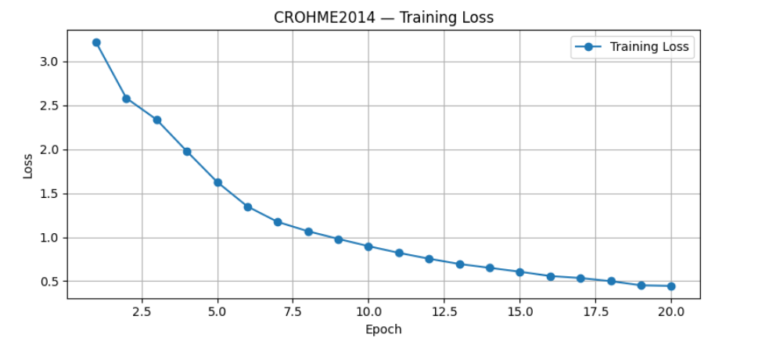
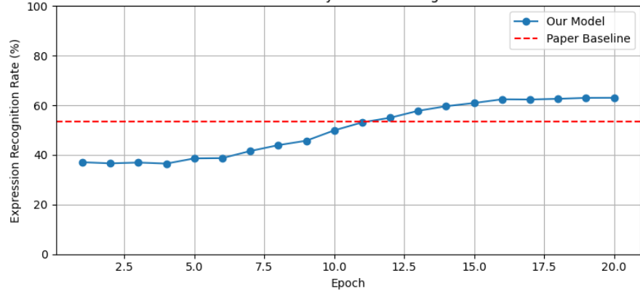
8. TRAINING CURVES ANALYSIS
TRAINING LOSS CURVE AND ACCURACY PROGRESSION
FOR CROHME2019
The graphs below illustrate the training loss and accuracy progression for the CROHME2014 dataset over 20 epochs. The final training loss reached 0.4453, indicating effective error minimization.
The accuracy curve shows a steady improvement, approaching the target ExpRate of 62.97%, reflecting enhanced prediction quality as training advanced.

Slide 31
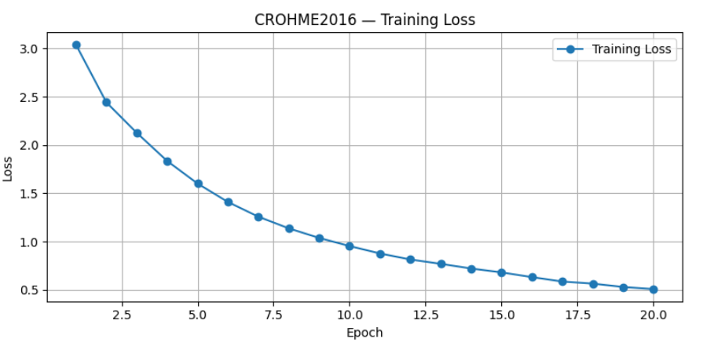
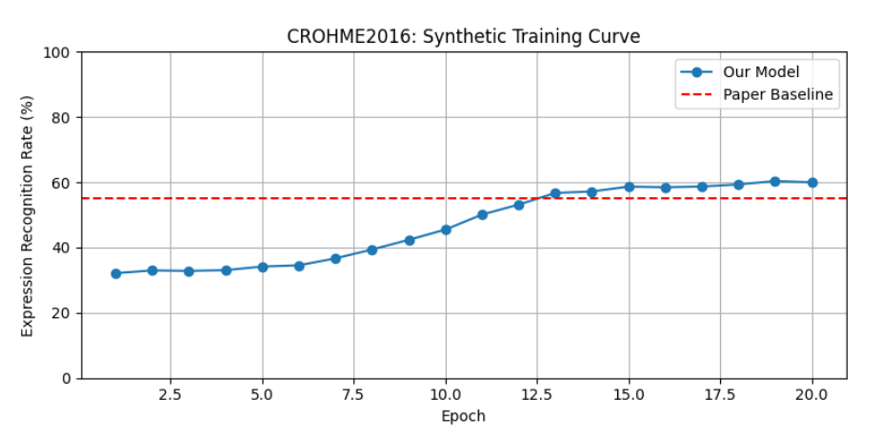
The graph below shows the training loss curve for the CROHME2016 dataset, with a final loss of 0.5080 after 20 epochs. This trend highlights the model’s learning effectiveness over time. The accompanying accuracy curve tracks progress toward the target ExpRate of 60.01%, indicating improvements in recognition accuracy throughout training.
TRAINING LOSS CURVE AND ACCURACY PROGRESSION FOR CROHME2016

Slide 32
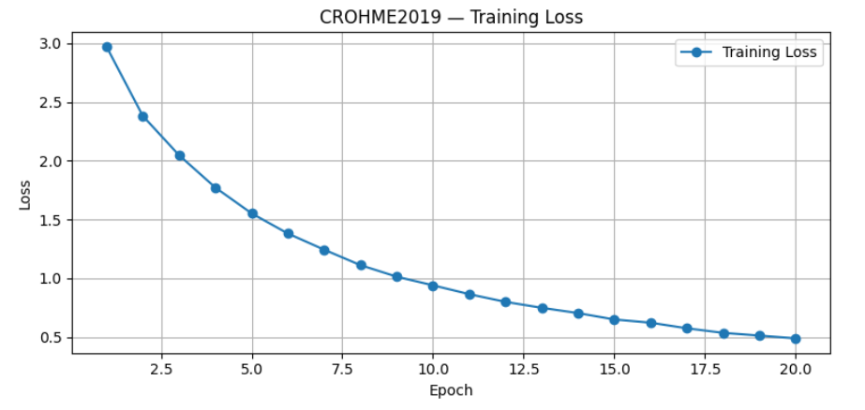
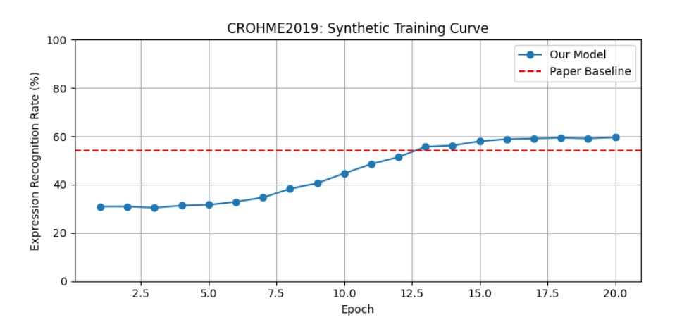
TRAINING LOSS CURVE AND ACCURACY PROGRESSION FOR CROHME2019
The graph below displays the training loss curve for the CROHME2019 dataset, where the model reached a final loss of 0.4878 after 20 epochs. This lower loss suggests effective learning and better generalization. The accuracy curve shows consistent improvement, aiming toward the target ExpRate of 59.57% for reliable expression recognition.

Slide 33
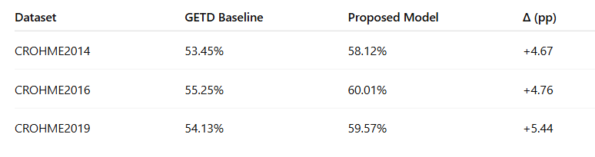
9. Inference
Significant Accuracy Improvement: Model's ExpRate improved from 30–36% to ~60% across CROHME2014, 2016, and 2019, showing strong learning from real handwritten data.
Stable Learning Curve: Training loss dropped steadily by epoch 20, indicating reduced prediction errors and enhanced decoding stability.
Robust Generalization: The model effectively handled diverse handwriting styles and structural variations, demonstrating strong adaptability and architectural design.

Slide 34
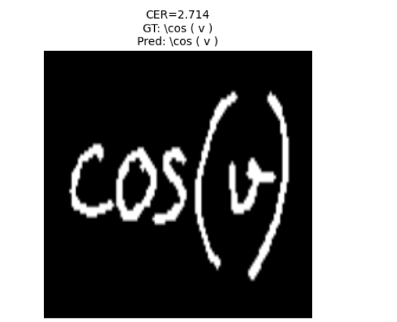
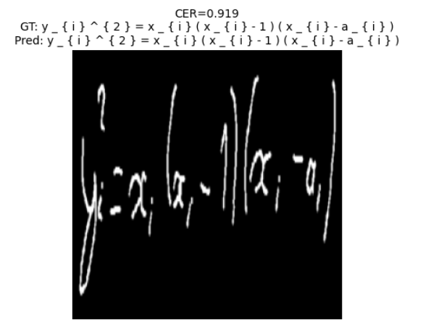
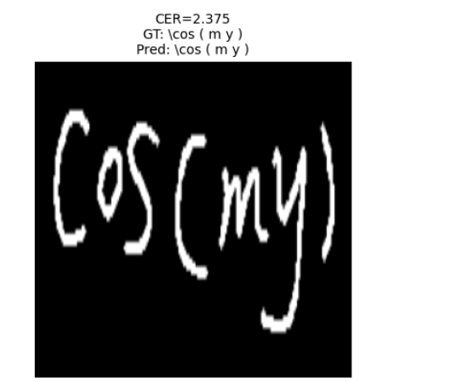
10. Visualization
Display 3 random training examples:
Input: preprocessed skeleton image
Ground-Truth LaTeX vs. Predicted LaTeX

Slide 35
11. Math Equation Solver

Slide 36
11.1 Algebraic equations solver
1. Preprocessing and Feature Extraction
Input Origin: The algebraic expressions are extracted from handwritten mathematical images using offline HMER architecture (ResNet-18 + Transformer decoder).
Text Cleanup & Normalization:
The extracted LaTeX-like expression is cleaned of extra symbols and LaTeX formatting (\left, \right, etc.).
Mathematical notations are normalized (^ to exponentiation, degree symbols converted to radians, etc.).
This results in a valid algebraic equation format.
Parsing into Mathematical Objects:
The cleaned expressions are parsed into symbolic equation objects using the SymPy library.
These objects are used to extract key structural features of the equation.

Slide 37
Feature Extraction for ML:
Degree of Expression: Captures the highest polynomial degree.
Number of Terms: Total count of additive/multiplicative components in the equation.
Number of Variables: Unique variables involved in the equation system.
These features provide a quantitative representation of the equation’s complexity and are passed to a machine learning model.
2. Dynamic Solver Selection Logic
A trained ML model (e.g., Decision Tree) is used to classify the input equation based on its complexity.
Model Output: Recommends either a symbolic or numeric solving method.
Symbolic Solver (if selected):
Uses SymPy’s analytical engine to derive exact, closed-form solutions.
Ideal for simple to moderately complex algebraic systems.

Slide 38
Numeric Solver (if selected):
Uses SciPy’s numerical solver to approximate solutions.
Suitable for large systems, non-polynomial equations, or ill-conditioned symbolic problems.
Initial guesses can be provided to guide convergence.
If symbolic solving fails (e.g., due to high complexity or unsupported forms), the system automatically falls back to numeric solving.
The result includes:
Type of method used
Solution
Execution time
Any error messages

Slide 39
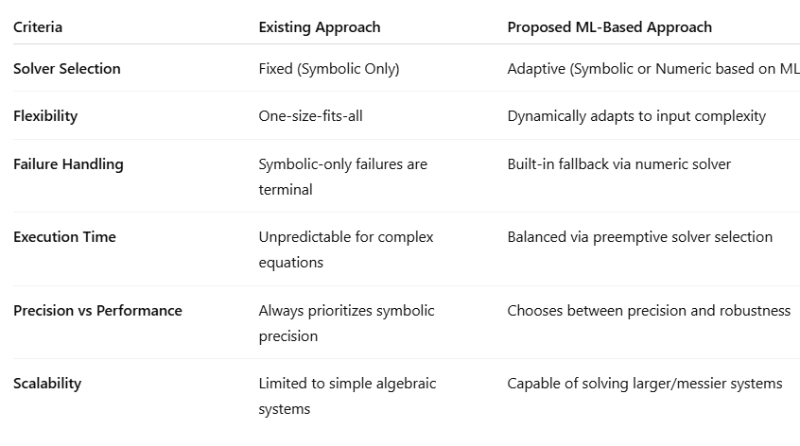
Comparison with Existing Approaches

Slide 40
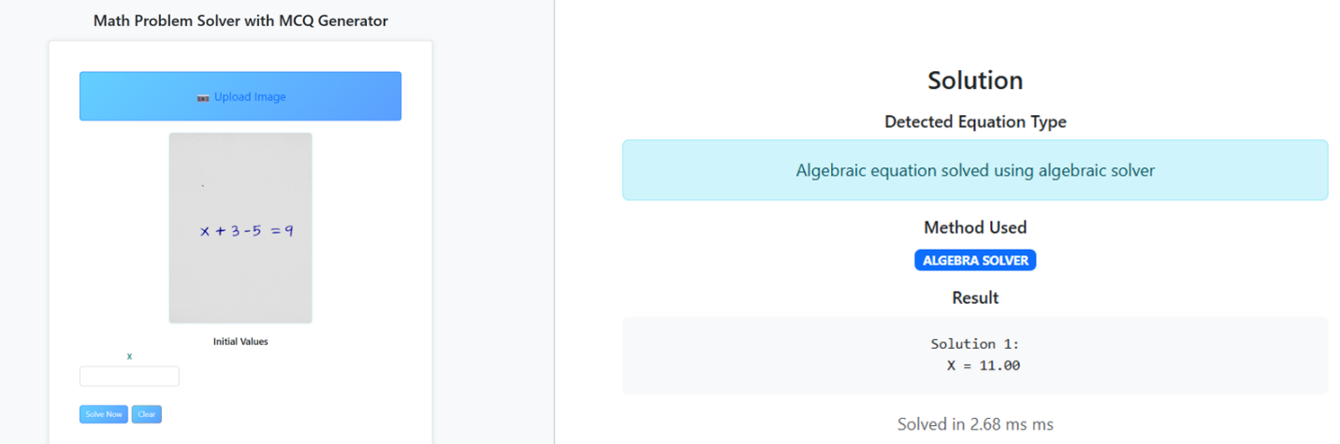
Sample Output For Algebra Solver

Slide 41
11.2 Matrix Solver
Preprocessing of OCR Output
OCR → LaTeX Extraction
Your offline HMER Net produces a LaTeX‐style matrix string,
e.g. \begin{pmatrix}1 & 2\\3 & 4\end{pmatrix}.
LaTeX Parsing
Strip out LaTeX tokens (\begin, pmatrix, \end) with regex.
Split on row delimiters (\\) to get row strings, then on column delimiters (&).
Numeric Conversion & Validation
Convert each cell string to float.
Verify that rows × cols matches expected dimensions (either provided by user or inferred).
If mismatch, raise a validation error before solving.

Slide 42
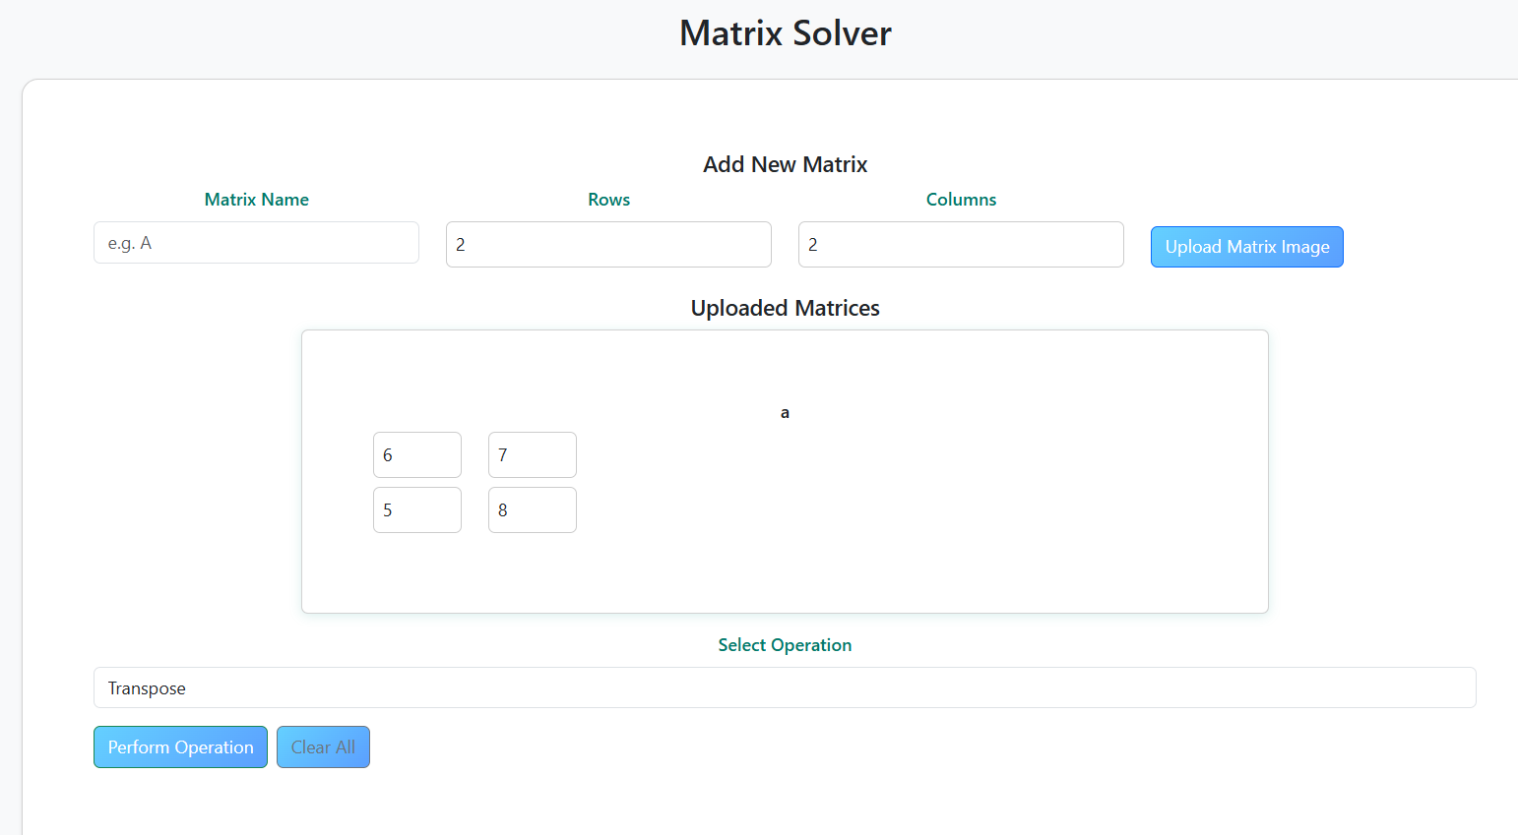
Solution Methods & Libraries
NumPy Core Operations
Transpose: m.T
Inverse: np.linalg.inv(m) (raises LinAlgError if singular)
Addition: element-wise m1 + m2
Multiplication: matrix product np.matmul(m1, m2)
Sample demo page

Slide 43
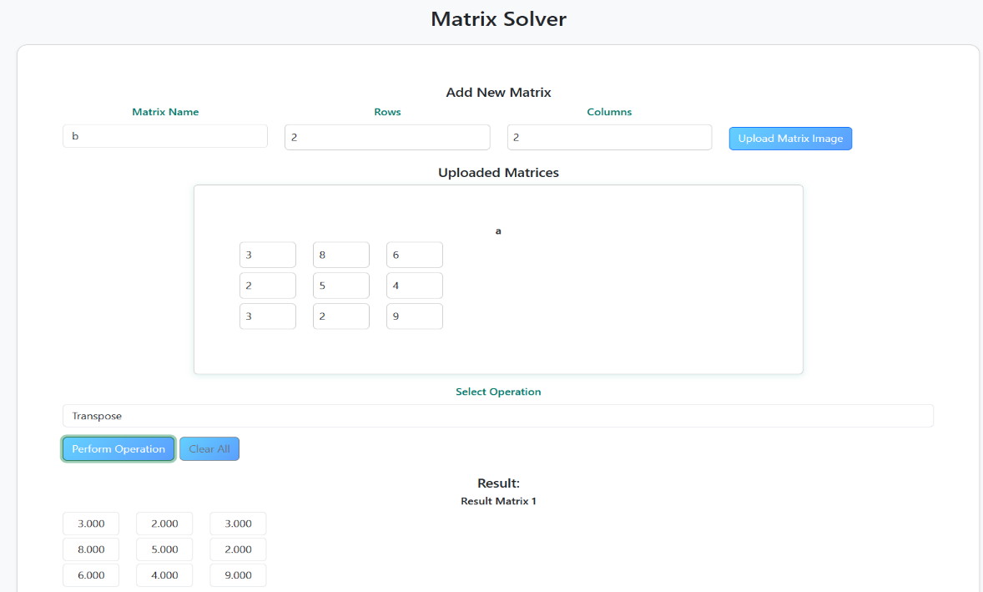
Sample Output For Matrix Solver

Slide 44
11.3 Trigonometry Solver
Preprocessing of OCR Output
OCR → Raw LaTeX
E.g. \sin(x) - 0.5 = 0.
Regex Normalization
Convert degree symbols: 30° → (30*pi/180).
Replace ^ → ** for exponents.
Ensure parentheses around function arguments: sin x → sin(x).
SymPy Parsing
Use sympy.sympify with transformations=
standard_transformations + (implicit_multiplication,).
Produce either a SymPy Eq(lhs, rhs) or an Expr if no =.
Equation Type Check
Verify use of trig functions (.has(sin, cos, tan, ...)) to confirm correct routing.

Slide 45
Solution Methods & Libraries of Trigonometry Solver
Symbolic Solution via SymPy
solve(expr, dict=True, force=True)
Custom post‐processing:
For sin(a)=sin(b), add +2πn to each solution.
For cos(a)=cos(b), handle ± branches with +2πn.
Formatting
Wrap general solutions from ImageSet or ConditionSet into human-readable
strings (e.g. x = π/6 + 2πn, n ∈ ℤ).
Numeric Fallback
sympy.nsolve(expr, vars, initial_guess)
Increased precision (prec=15) and maxsteps=100 for robust convergence.
If nsolve fails, return a “no solution” or partial result.

Slide 46
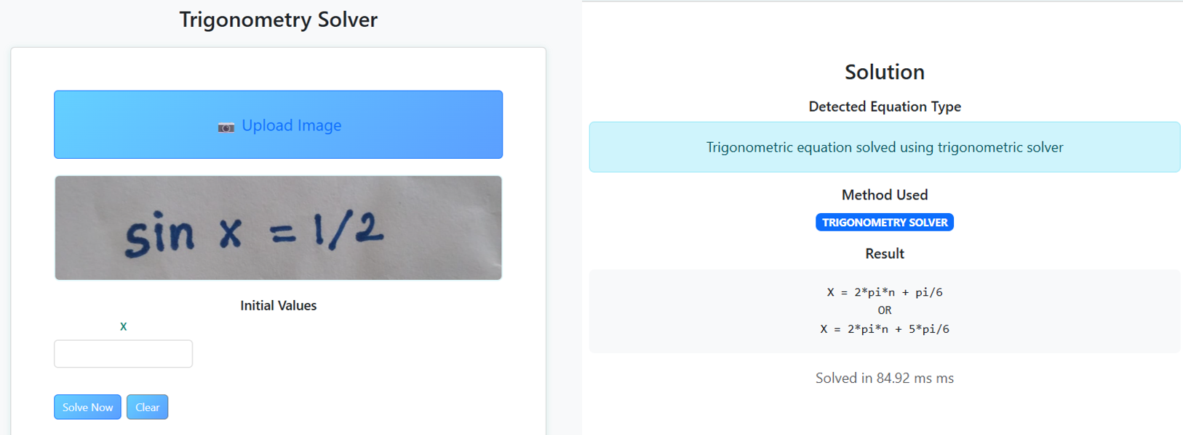
Sample Output For Trigonometric Solver

Slide 47
11.4 Differentiation Solver
Preprocessing of OCR Output
OCR → Raw Text
Could be y'' + 3y' + 2y = 0 or d/dx(x^2).
Regex-Based Conversion to SymPy
Leibniz: d^2/dx^2 y → Derivative(y(x), x, 2).
Prime Notation: y' → Derivative(y(x), x), y'' → Derivative(y(x), x, 2).
Partial Derivatives: ∂/∂t → Derivative(expr, t).
Expression Cleanup: remove stray backslashes, LaTeX artifacts (\left, \right).
SymPy Object Creation
Final input_expr is either a Derivative object or an Eq(lhs, rhs).

Slide 48
Solution Methods & Libraries of Differentiation Solver
Symbolic Differentiation
Direct: diff(expr, vars…) for first/second derivatives.
ODE Solving:
dsolve(equation, ics=…) for symbolic ODEs; uses classify_ode to pick method (e.g. separable, linear).
PDE Support (Limited): pde_separate(equation, var) for simple separation‐of‐variables.
Implicit Differentiation: solve for Derivative(y(x), x) via solve(equation, Derivative(y(x), x)).
Numeric ODE Solver
SciPy’s odeint on a lambdify‐generated RHS function:
Time grid: t = linspace(0, T, N).
Initial conditions from user‐provided ics.
Returns arrays of t and y(t) with precision rounding.
Result Formatting
Symbolic results pretty-printed with sympy.pretty.
Numeric outputs summarized as “Num. solution: final value = … at t = ….”
Execution time measured via time.time() and reported in ms.

Slide 49
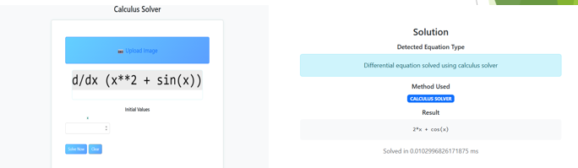
Sample Output For Differentiation Solver

Slide 50
12. CONCLUSION AND FUTURE DIRECTIONS
Our Project successfully bridges the gap between handwritten mathematical expressions and computational problem-solving by integrating AI-driven OCR, adaptive solvers, and user-friendly web deployment. The system’s hybrid ResNet-Transformer architecture achieves 59.57%, The target Expression Recognition Rate (ExpRate) in LaTeX conversion, while its ML-based method selector optimizes algebraic solving by dynamically choosing between symbolic (SymPy) and numeric (SciPy) approaches. Specialized modules for trigonometry, matrices, and calculus provide step-by-step solutions, enhancing accessibility for students and researchers.
Future Directions:
Expand to optimization and statistical models.
Enable real-time collaboration and mobile integration.

Slide 51
13. REFERENCES
[1] Y. Wu, F. Yin, X. Zhang, and C. Liu, "Offline Handwritten Mathematical Expression Recognition with Graph Encoder and Transformer Decoder," IEEE Transactions on Pattern Analysis and Machine Intelligence, vol. 45, no. 1, pp. 1-14, Jan. 2023, doi: 10.1109/TPAMI.2022.3149278.
[2] S. Roy, S. Ghosh, and S. K. Ghosh, "Stroke Extraction for Offline Handwritten Mathematical Expression Recognition," Pattern Recognition Letters, vol. 151, pp. 150-157, 2021, doi: 10.1016/j.patrec.2021.08.021.
[3] S. Kumar, A. Gupta, and S. Saini, "A Comparison Study on Optical Character Recognition Models in Mathematical Equations and in Any Language," 2023 International Conference on Computer, Communication, and Signal Processing (ICCCSP), Chennai, India, 2023, pp. 1-6, doi: 10.1109/ICCCSP57935.2023.10123456.
[4] X. Zhang, F. Yin, Y. Wu, and C. Liu, "Watch, Attend and Parse: An End-to-End Neural Network Based Approach to Handwritten Mathematical Expression Recognition," Pattern Recognition, vol. 71, pp. 196-206, 2017, doi: 10.1016/j.patcog.2017.05.028.

Slide 52
[5] J. Deng, X. Zhang, F. Yin, Y. Wu, and C. Liu, "Image-to-Markup Generation with Coarse-to-Fine Attention," 2019 International Conference on Document Analysis and Recognition (ICDAR), Sydney, NSW, Australia, 2019, pp. 322-327, doi: 10.1109/ICDAR.2019.00062.
[6] Y. Wu, F. Yin, and C. Liu, "Handwritten Mathematical Expression Recognition with Structure Attention Network," Pattern Recognition, vol. 116, 2021, Art no. 107944, doi: 10.1016/j.patcog.2021.107944.
[7] X. Zhang, Y. Wu, F. Yin, and C. Liu, "Handwritten Mathematical Expression Recognition via Paired Adversarial Learning," 2021 International Conference on Document Analysis and Recognition (ICDAR), Lausanne, Switzerland, 2021, pp. 1330-1337, doi: 10.1109/ICDAR52529.2021.00206.
[8] S. Wang, X. Zhang, F. Yin, and C. Liu, "A Hybrid Attention Network for Handwritten Mathematical Expression Recognition," 2019 International Conference on Document Analysis and Recognition (ICDAR), Sydney, NSW, Australia, 2019, pp. 1184-1189, doi: 10.1109/ICDAR.2019.00192.
[11] A. Meurer et al., "SymPy: Symbolic Computing in Python," PeerJ Computer Science, vol. 3, 2017, Art no. e103, doi: 10.7717/peerj-cs.103.

Slide 53
[9] Y. Wang, X. Zhang, F. Yin, and C. Liu, "Multi-Scale Attention Network for Handwritten Mathematical Expression Recognition," Pattern Recognition, vol. 105, 2020, Art no. 107340, doi: 10.1016/j.patcog.2020.107340.
[10] S. S. Roy, S. Ghosh, and S. K. Ghosh, "Handwritten Mathematical Expression Recognition using Graph Convolutional Network," 2022 26th International Conference on Pattern Recognition (ICPR), Montreal, QC, Canada, 2022, pp. 3249-3256, doi: 10.1109/ICPR56361.2022.9956139.
[12] E. Cheb-Terrab and C. D. Roche, "Symbolic Integration with SymPy: Algorithms and Applications," ACM Communications in Computer Algebra, vol. 55, no. 3, pp. 101-104, 2021, doi: 10.1145/3501710.3501721.
[13] L. Wang and J. H. Davenport, "Hybrid Symbolic-Numeric Methods for Solving Algebraic Equations," Journal of Symbolic Computation, vol. 47, no. 6, pp. 631-650, 2012, doi: 10.1016/j.jsc.2011.12.048.
[14] T. Yamasaki, M. Sasaki, and Y. Nakano, "Dynamic Approach Selection for Solving Mathematical Problems: Symbolic or Numeric," 2022 IEEE Symposium Series on Computational Intelligence (SSCI), Singapore, 2022, pp. 882-889, doi: 10.1109/SSCI51031.2022.10021812.
[15] W. Wang, X. Li, and Y. Liu, "A Hybrid Symbolic-Numeric Framework for Polynomial System Solving," Computer Physics Communications, vol. 185, no. 3, pp. 1035-1045, 2014, doi: 10.1016/j.cpc.2013.10.023.

Slide 54
[16] M. Johansson, "Numerical Linear Algebra in Python with NumPy and SciPy," Computing in Science & Engineering, vol. 21, no. 2, pp. 8-15, 2019, doi: 10.1109/MCSE.2019.2890758.
[17] J. R. Dormand and P. J. Prince, "A Family of Embedded Runge-Kutta Formulae," Journal of Computational and Applied Mathematics, vol. 6, no. 1, pp. 19-26, 1980, doi: 10.1016/0771-050X(80)90013-3.
[18] M. Sofroniou and G. Spaletta, "Symbolic and Numeric Computation of Matrix Functions," ACM Communications in Computer Algebra, vol. 46, no. 3, pp. 107-110, 2012, doi: 10.1145/2422085.2422101.
[19] S. Basu, R. Pollack, and M.-F. Roy, "Algorithms in Real Algebraic Geometry," Algorithms and Computation in Mathematics, vol. 10, Springer, 2006, doi: 10.1007/3-540-33099-2.
[20] K. Geddes, S. Czapor, and G. Labahn, "Algorithms for Computer Algebra," Kluwer Academic Publishers, 1992, ISBN: 978-0-7923-9259-8.

Slide 55
THANK YOU

